Slide 1
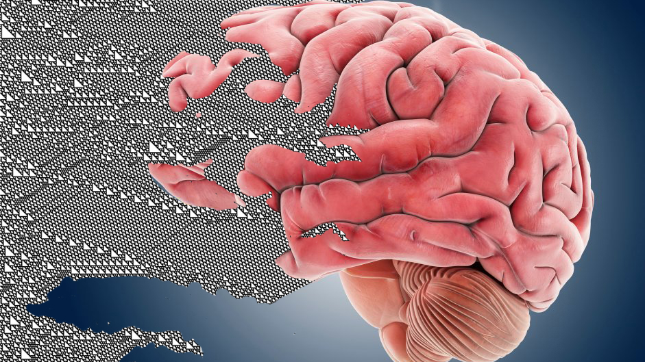
Hybrid spiking neuron – cellular automata model
Notes:
Hi everyone!
As some of you know the current COVID-19 situation has meant that access to the neuroscience lab at NTNU is heavily limited and thus we have not been able to make much progress on the biological reservoir part of the DeepCA project.
Instead I have been partly working on creating a modelling framework to simulate neural networks and the interface between these and cellular automata.

Slide 2

Overview
Reservoir computing
Framework
Demonstrations
Preliminary analysis
Future work

Slide 3

Reservoir computing
General structure
Special case: The liquid state machine
Motivation: Increasing the computational power of liquids

Slide 4
General structure
Two components
Reservoir
High dimensional (higher than input)
Non – linear units
Highly recurrent
Readout
Linear readout units
Input Reservoir Readout

Slide 5
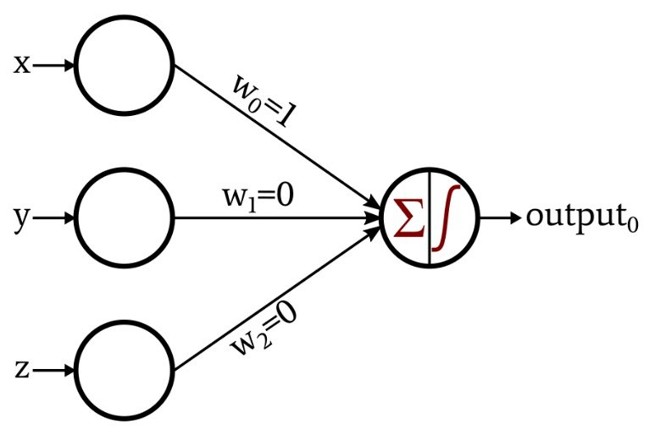
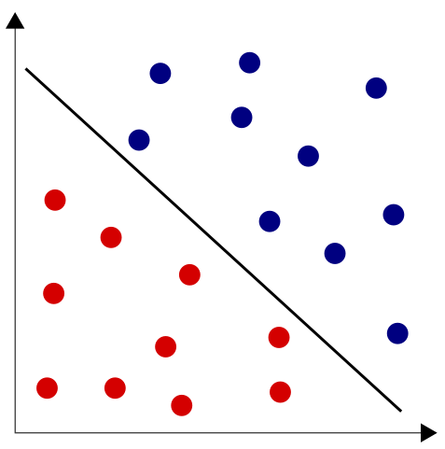
The perceptron
Mathematically abstracted neuron
Can learn to separate points with a straight line

Slide 6
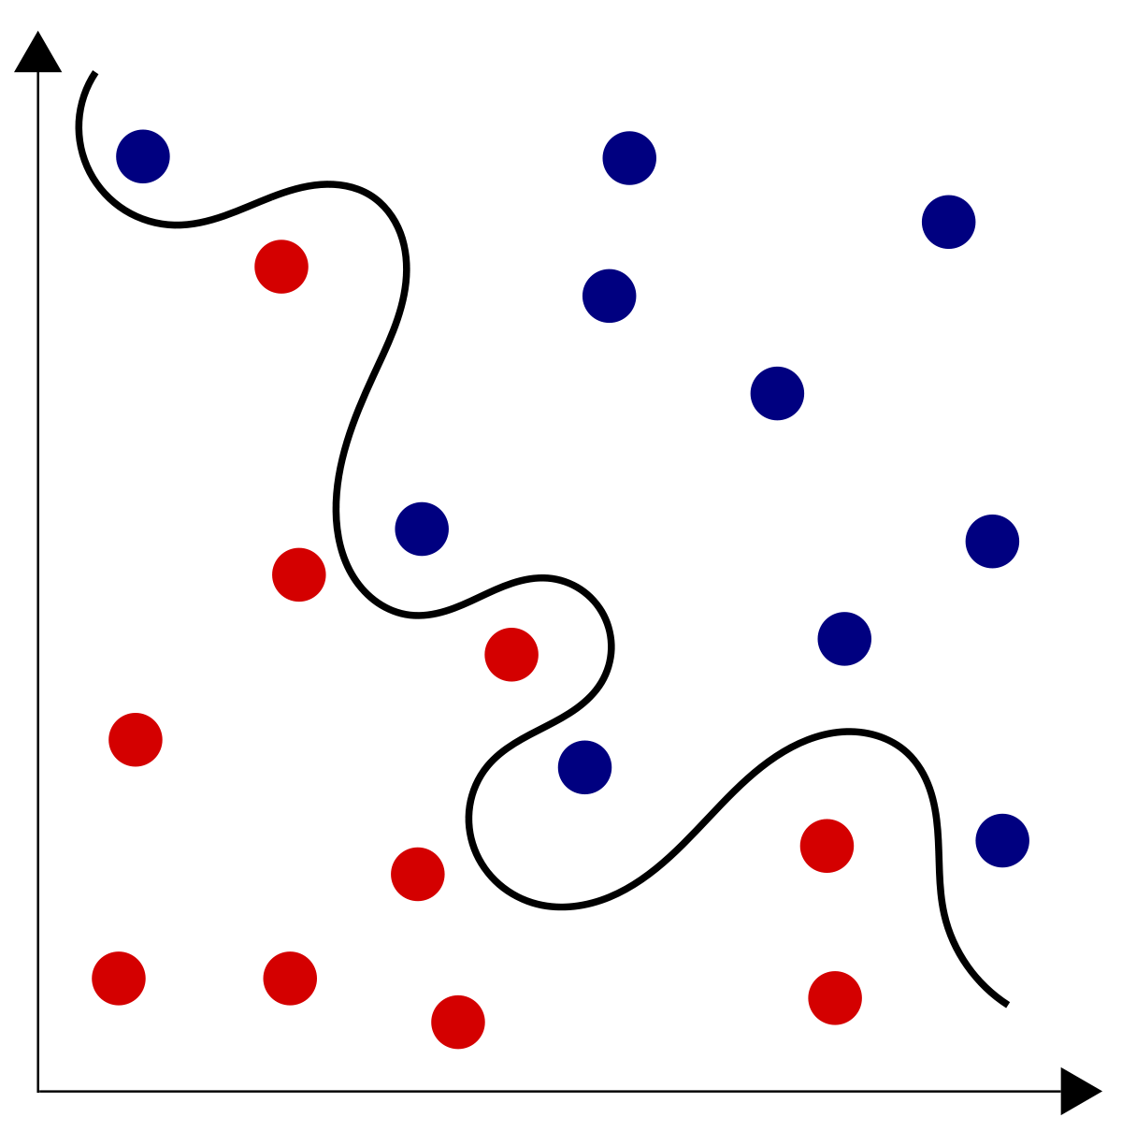
The perceptron
But what if we need a squiggly line?

Slide 7

Deep neural networks
Can find squiggly lines?

Slide 8
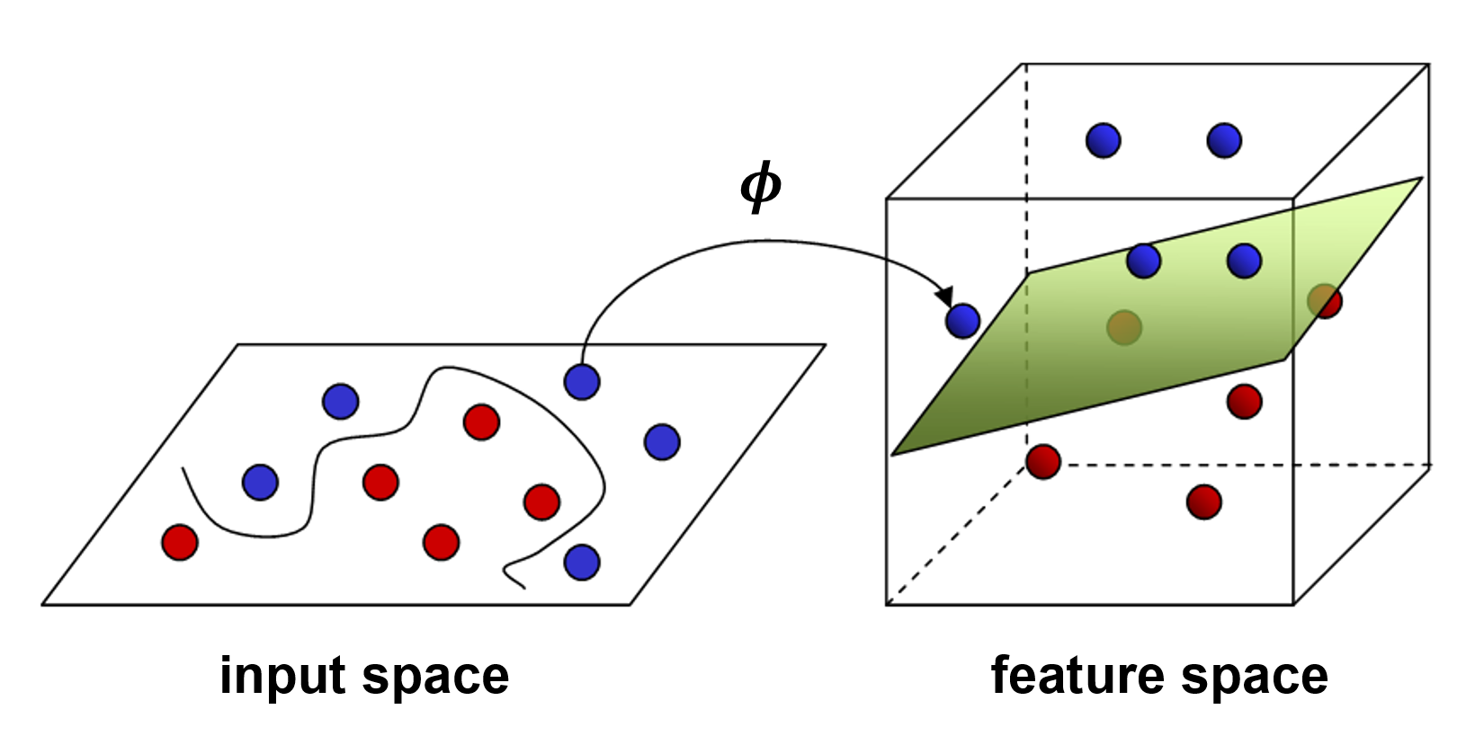
Reservoir computing:
Projects input into higher dimensional space such that data becomes linearly separable

Slide 9
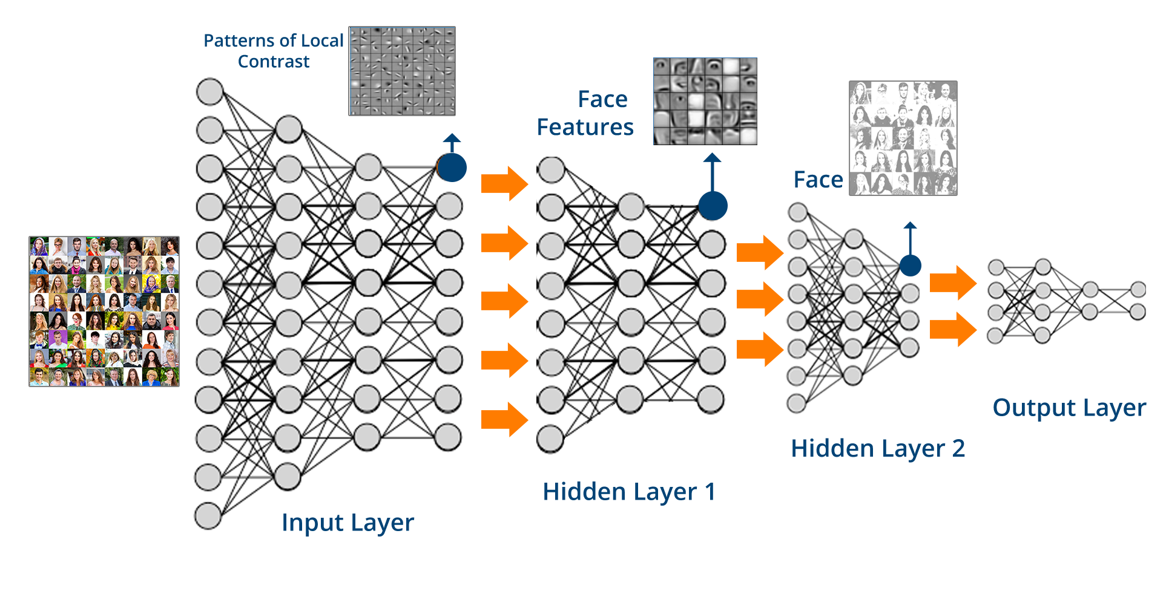
Benefit: Cheap training
Input Reservoir Readout
Only train output
Train everything

Slide 10
Linearizing problems through hyper dimensional projection Example using cellular automata on the XOR problem

Slide 11
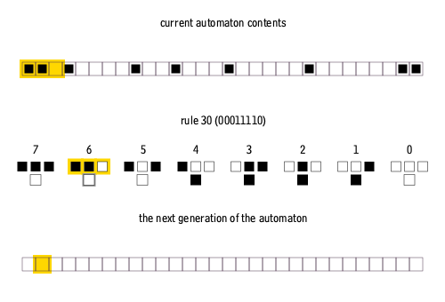
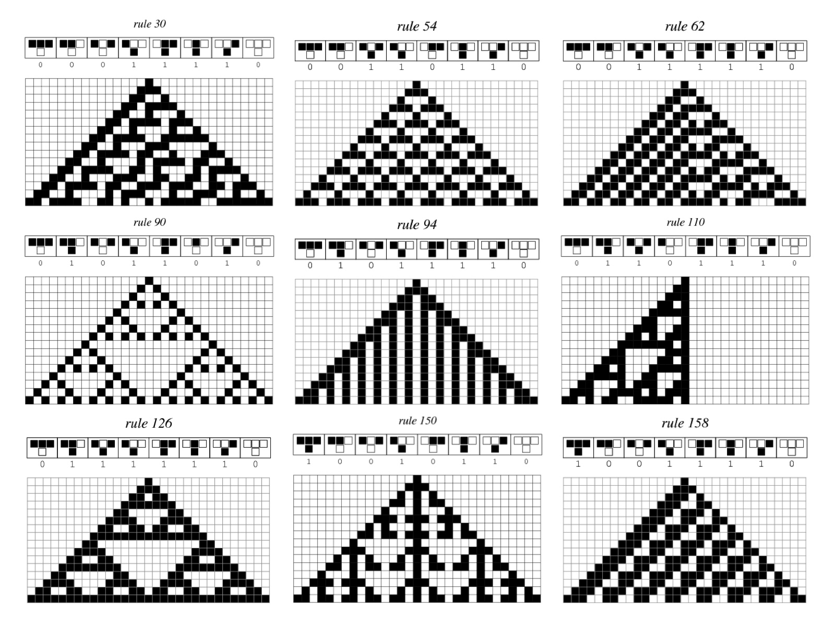
1D cellular automata
Current state = Boolean array of 1’s and 0’s
The “1D” in the cellular automata refers to the number of axis of the array representing the current state.
An 1D array of size 200 is the same as a 200 dimensional vector, i.e a vector describing a point in 200 dimensional space
Current state is updated using a transition function (here rule 30)
Computes new values in the Boolean array based on the values of each pixel and it’s two neighbours

Slide 12
Example - XOR in cellular automata reservoir
The XOR problem
Represented as an 1D array of size 2 ( = 2 dimensional vector)
The problem and correct output
[0,0] = 0
[1,0] = 1
[0,1] = 1
[1,1] = 0
The vector representing the input is mapped into the cellular automata
We have now mapped a 2D input vector into a n dimensional representational space where n = the size of the automata
In other words we have created a high dimensional projection
As the cellular automata computes new states, these might provide a linearized version of the input problem
0
0
1
0
0
0
0
0
1
0

Slide 13
Example - XOR in cellular automata reservoir
Time:
0 1 2 3 4 5 6 7 8 9 10 11 12 13 14 15
Projecting into time
The input to the readout neurons does not need to be just the current state
The automata can run for some time and all the computed states can be used as input
This lets us project into an infinite dimensional space
Dimension of representational space = Automata size x nr of time steps

Slide 14
XOR problem – starting states
0
0
1
0
0
0
0
0
0
0
0
0
0
0
0
0
Each input value is mapped into the starting state of identical cellular automata at identical locations
Each automata is then allowed to run for n time-steps
1
0
0
0
0
0
0
0
0
1
0
0
0
0
1
0
0
1
0
0
0
1
1
1

Slide 15
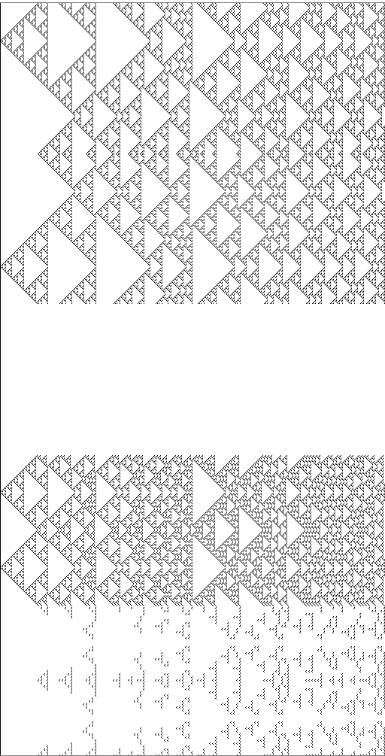
XOR problem – Resulting time projections
The pattern of activity in each run of the cellular automata are different
The XOR problem is solved by those cell values that are = 1 only for the [1,0] and [0,1] input cases
1
0
0
0
0
1
1
1

Slide 16
XOR problem – Solutions
Each black pixel is a solution
The readout only need to learn to detect whether any of these pixels are either on or off
This is only one easily computable solution. Solutions could also exist as unique pixel combinations, not just single pixels

Slide 17
XOR problem – Solutions
Notably solutions cannot arise until the values from the input location has propagated such that they may interact
This is because all 1 values generated by the [1,0] and [0,1] input overlap with the [1,1] input until the activity from the [1,1] input can start to interact
Point of first interaction

Slide 18
XOR problem – Solutions
The array elements that solve the XOR problem = the feature dimension
In other words it corresponds to the z axis in the feature space figure

Slide 19
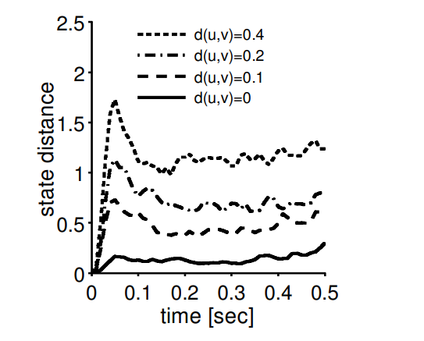
Special case of reservoir computing - The liquid state machine
Liquid state distance
Liquid state machines can be anything but was suggested as a model for cortical circuits
Liquid states are spike vectors
Does not store previous states – does not do time projection
Has universal computational ability
On time varying input with fading memory
Need to fulfil two criteria
The liquid (reservoir) must have the separation property
Significantly different input causes significantly different liquid states
Good reservoirs conserves the ratio between inputs distances in liquid states distances (see figure)
The readout must have the approximation property
It must be able to transform different liquid states into different target output
d(u,v) = x.x : distance between input patterns

Slide 20

Liquid state machines – fading memory
Definition:
The current state of the liquid is only dependent on the current input and the liquid states up to a finite point back in time
Intuition:
Imagine a bucket of water, if you drop a pebble into it the waves will spread for a while until the water settles. While the waves still propagate they represent a memory of where and when the pebble was dropped
The size of the ring = time since the pebble was dropped
The centre of the ring = where it was dropped

Slide 21

Liquid state machines – fading memory
If multiple pebbles are dropped into the bucket at different times and locations all the information of where and when all the pebbles hit the water is contained in a single snapshot of the waves
Benefit:
We do not have to do backpropagation through time to learn temporal patterns as we only need to recognize a pattern of waves
The liquid state machine also learn to equate multiple wave patterns such that the readout can give the same output for propagating waves and not only a single snapshot of the waves

Slide 22
Order and chaos - Order
Static systems:
Static systems do not change. Using the water example this would be the same as ice. You can input information, dropping a pebble at a block of ice, which will leave a mark, but dropping the pebble will not cause information to propagate through the ice such that it can interfere with memories of other pebbles dropped at the ice.
It has perfect memory – but no computation
Referring back to the cellular automata example, starting states is equivalent to the pebbles we drop into the water/ice. And the propagation of the 1’s or “on” cells is equivalent to waves. As pointed out the “waves” in the cellular automata had to interfere for the solution to the XOR problem to arise.
This would not be possible in a static system as the effect of the pebbles on the ice stays stationary and thus does not get the chance to interfere

Slide 23
Order and chaos - Order
Unchanging and convergent systems:
Some systems may display behaviour unaffected by input. Like throwing a pillow at a rock – there is no effect on the rock
Or different input always result in the same result
Ex: a neural network where all inputs always result in identical population bursts
General definition: Systems that quickly converge to same state
In the water analogy – waves quickly settling to a quiet surface before they get a chance to interact

Slide 24
Order and chaos - chaos
Changing systems :
Dropping two pebbles in water causes two circle waves to form. If we were to first drop two pebbles in a bucket of water, watch the patterns of waves and then after the waves have settled, drop two more pebbles in the water, but a slightly different positions to the first two we would observe a slightly different but similar pattern of waves.
A truly chaotic system will on the other hand result in a completely different wave pattern even if the difference between when and where we drop the second two pebbles compared with the two first is miniscule.
In continuous systems this makes it impossible to calculate what caused the wave pattern because even miniscule rounding errors can lead to completely wrong answers of where and when the pebbles were dropped into the liquid
We do not have any memory
This also makes it difficult to use chaotic systems for classification.
If the wave patterns caused by similar inputs are similar then one might just have to learn one more weight to learn that these two patterns are equivalent because most of the waves overlap and you only need to learn the small difference.
If the wave patterns are completely different you have to learn an entire new set of weights
General definition: Systems that quickly diverge to different states
In the water analogy: the waves never settle down

Slide 25
Order and chaos – edge of chaos
The examples given so far are extremes at either side of a phase space.
Systems can exist at any point in between each of these extremes
The transition between these two phases is called the edge of chaos
The edge of chaos has aspects of both chaos and order
Instead of static memory it has fading memory
Instead of complete divergence of states, similar input result in similar states
Some cellular automata rules result in systems at the edge of chaos
Ex: Rule 110, Conway’s game of life
These can be Turing complete
Neural systems can be tuned to the edge of chaos
Take a look at Kristine’s paper

Slide 26
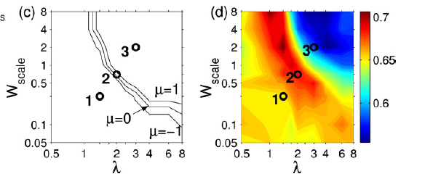
The edge of chaos
In models the edge of chaos can be tuned based on different parameters.
It can be arrived on in multiple different ways which can provide different benefits
Figure from [Legenstein and Maas]:
Top: edge of chaos as a line given by Lyapunov exponents μ of 0 as found in computational models varying two parameters
Bottom: performance of a linear readout layer on a computational task
The region surrounding the edge of chaos may also provide different benefits
Suggestion: shorter or longer memory lengths
Shorter for words?
Longer for sentences?

Slide 27
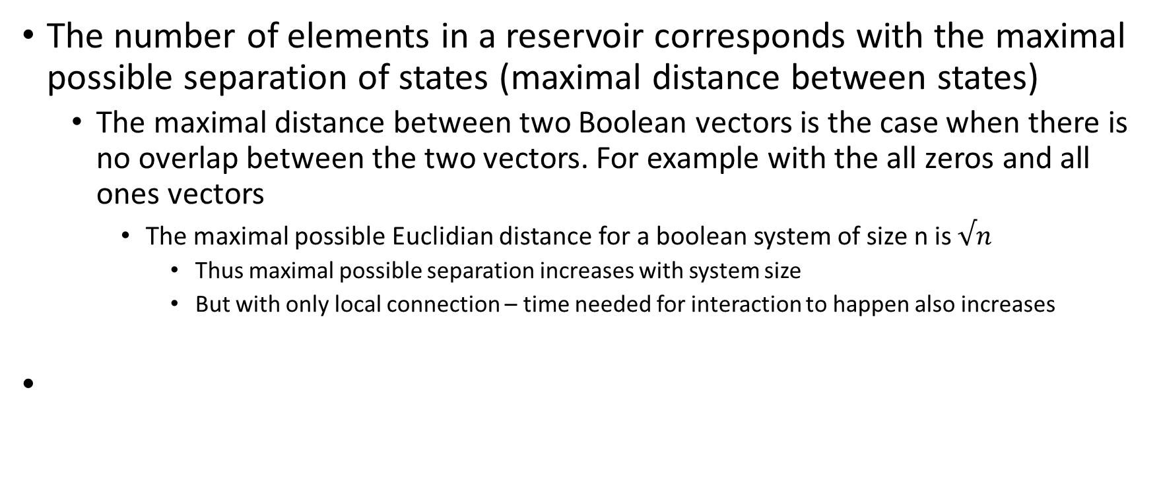
Additional important features
The number of elements in a reservoir corresponds with the maximal possible separation of states (maximal distance between states)
The maximal distance between two Boolean vectors is the case when there is no overlap between the two vectors. For example with the all zeros and all ones vectors
The maximal possible Euclidian distance for a boolean system of size n is $√n$
Thus maximal possible separation increases with system size
But with only local connection – time needed for interaction to happen also increases

Slide 28
Increasing the computational performance of liquids - Cortical columns and deep networks
Maas, Natschläger and Markram (2002):
Adding more connections within a column increases separation but in a quasi chaotic manner
Gallicchio, Micheli and Pedrelli (2017):
Deep echo state networks could diversify temporal representations of inputs
Higher layers remembered perturbations longer
Connecting columns increased separation and conserved distance ratio found in inputs
Spiking neural network shaped like a column
Increases the maximal possible separation but conserves desired edge of chaos behaviour

Slide 29
Increasing the computational performance of liquids - hybrid solutions
Different substrates may have inherently different computational abilities
Memory lengths
Type of computation
Motion
Integration
Addition
Coincidence detection
Etc
Combining these may lead to improved performance
By increasing the separation property

Slide 30
Framework
Goals
Neuron model
Interfacing
Cellular automata

Slide 31

Framework goals
Create a framework for designing reservoir computing systems with the following capacities
Combine existing features known to improve reservoir quality
Connectable columns
Deep networks
Use different types of substrates
Different neuron types
Cellular automata
Simulate simplified interface with biological neurons and CA

Slide 32
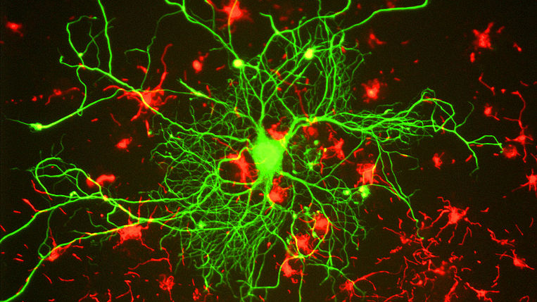
Neuron model

Slide 33
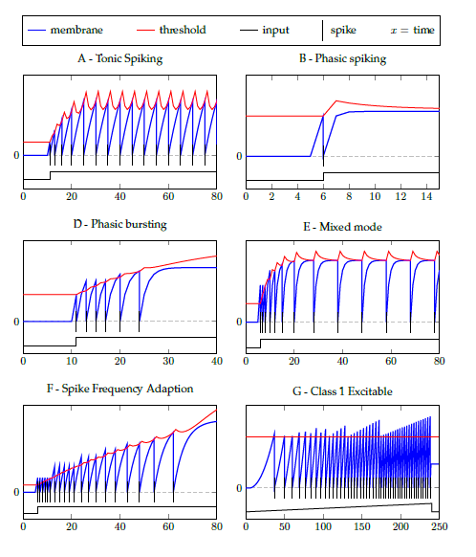
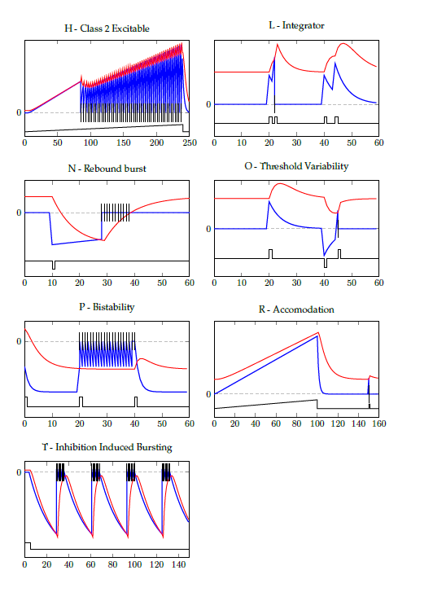
Neuron Model: neuron types
Three parameters defines somatic behaviour
Different neuron behaviour can be created by varying parameters
Additional features can be added
Dynamic synapses
Dendritic compartments
Image on the right shows some of the different firing patterns possible
Notes:
Neuron population are quite easily simulated using python modules like numpy or cupy. This is due to the fact that functions are applied to all elements of an array in parallel making such implementations extremely fast.
For the current implementation I am using an adaptive spiking neuron model which functions in discreet time. This model has 3 parameters which determines the neuron’s spiking behaviour and is capable of creating a fairly wide range of spike patterns by using different values of these paramaters
Thus we can create a wide range of different neuron populations by applying the model function with different paramters to different 2D arrays.

Slide 34
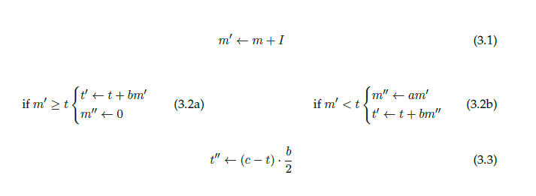
Neuron Model: neuron types
State values
m = membrane value
t = threshold value
I = input
Parameters
a = membrane decay
b = threshold adaptation rate
c = resting threshold-membrane difference
Notes:
Neuron population are quite easily simulated using python modules like numpy or cupy. This is due to the fact that functions are applied to all elements of an array in parallel making such implementations extremely fast.
For the current implementation I am using an adaptive spiking neuron model which functions in discreet time. This model has 3 parameters which determines the neuron’s spiking behaviour and is capable of creating a fairly wide range of spike patterns by using different values of these paramaters
Thus we can create a wide range of different neuron populations by applying the model function with different paramters to different 2D arrays.

Slide 35
Neuron Model: neuron types
Neuron model is applied on 2d arrays
Arrays can be:
homogenous population of the same type of neuron
All neurons in an array uses the same parameter values
heterogenous arrays of different neuron types
Each neuron uses different parameter values
Single neuron
Notes:
Neuron population are quite easily simulated using python modules like numpy or cupy. This is due to the fact that functions are applied to all elements of an array in parallel making such implementations extremely fast.
For the current implementation I am using an adaptive spiking neuron model which functions in discreet time. This model has 3 parameters which determines the neuron’s spiking behaviour and is capable of creating a fairly wide range of spike patterns by using different values of these paramaters
Thus we can create a wide range of different neuron populations by applying the model function with different paramters to different 2D arrays.

Slide 36
Neuron Model: neuron types
Different neuron population can be stacked
Different types are identified by different colours
Notes:
Neuron population are quite easily simulated using python modules like numpy or cupy. This is due to the fact that functions are applied to all elements of an array in parallel making such implementations extremely fast.
For the current implementation I am using an adaptive spiking neuron model which functions in discreet time. This model has 3 parameters which determines the neuron’s spiking behaviour and is capable of creating a fairly wide range of spike patterns by using different values of these paramaters
Thus we can create a wide range of different neuron populations by applying the model function with different paramters to different 2D arrays.

Slide 37
Creating cortical columns
Columns can be created by connecting vertically aligned neurons (blue arrows)
The connections scheme is identical for every column
Notes:
The key idea from this little tour of the organization of the brain is that there are population of essentially identical neurons which are spread out across functional brain areas in 2D sheets. These are then stacked on top each other to form 3D plates corresponding to functional brain areas.

Slide 38
Connecting cortical columns
Columns can be created by connecting vertically aligned neurons (blue arrows)
The connections scheme is identical for every column
Columns can be connected by connecting adjacent neurons
Either within one population (orange arrows)
Notes:
The key idea from this little tour of the organization of the brain is that there are population of essentially identical neurons which are spread out across functional brain areas in 2D sheets. These are then stacked on top each other to form 3D plates corresponding to functional brain areas.

Slide 39
Connecting cortical columns
Columns can be created by connecting vertically aligned neurons (blue arrows)
The connections scheme is identical for every column
Columns can be connected by connecting adjacent neurons
Either within one population (orange arrows)
Or projected to a different population (red arrows)
Notes:
The key idea from this little tour of the organization of the brain is that there are population of essentially identical neurons which are spread out across functional brain areas in 2D sheets. These are then stacked on top each other to form 3D plates corresponding to functional brain areas.

Slide 40
Creating “meta” Deep structures
By grouping a stack of neuron populations we can consider these a functional area
These are collections of identical cortical columns
Grouping is only defined by connection scheme
Functional areas can be connected similarly to how neuron populations are connected
This is just one potential connection scheme. Created to mimic the brain’s structure

Slide 41
Brain correspondences
2d array of neurons (neuron population)
=cortical layer
3d stack of neuron populations
= Functional area

Slide 42
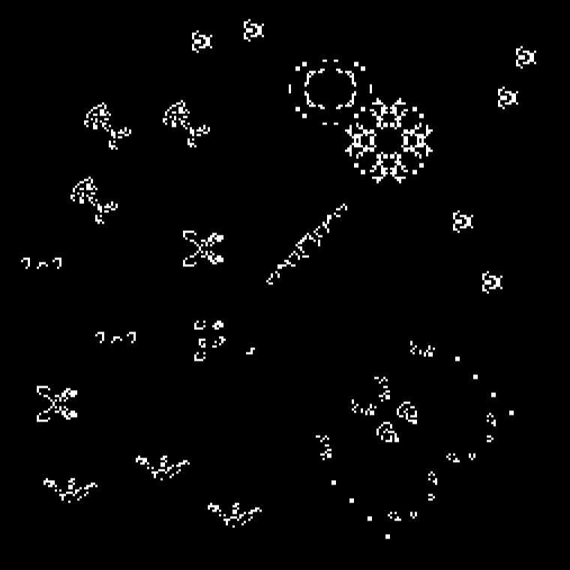
Interfacing cellular automata with neuron populations
Any 2d cellular automata can simply be used as a neuron population
Connection schemes used for neuron populations can be used the same way
Lateral connections within population = neighbourhood
Notes:
Neuron population are quite easily simulated using python modules like numpy or cupy. This is due to the fact that functions are applied to all elements of an array in parallel making such implementations extremely fast.
For the current implementation I am using an adaptive spiking neuron model which functions in discreet time. This model has 3 parameters which determines the neuron’s spiking behaviour and is capable of creating a fairly wide range of spike patterns by using different values of these paramaters
Thus we can create a wide range of different neuron populations by applying the model function with different paramters to different 2D arrays.

Slide 43
Interfacing cellular automata with neuron populations
1D automata
2D spike array
1D cellular automata
Input to neuron population
If the number of cells == number of neurons
Current state can be reshaped into 2d array
Reshape
Notes:
Neuron population are quite easily simulated using python modules like numpy or cupy. This is due to the fact that functions are applied to all elements of an array in parallel making such implementations extremely fast.
For the current implementation I am using an adaptive spiking neuron model which functions in discreet time. This model has 3 parameters which determines the neuron’s spiking behaviour and is capable of creating a fairly wide range of spike patterns by using different values of these paramaters
Thus we can create a wide range of different neuron populations by applying the model function with different paramters to different 2D arrays.

Slide 44
Interfacing cellular automata with neuron populations
1D automata
2D spike array
1D cellular automata
Input to neuron population
If the number of cells == number of neurons
Current state can be reshaped into 2d array
If the number of cells < number of neurons
Current state can be indexed as input into any shape into the population
Direct input of same shape
Sparse reshape of population
1
1
0
0
1 | 0 | 0 | 0 | 0
1 | 0 | 0 | 0 | 0
0 | 0 | 0 | 0 | 0
0 | 0 | 0 | 0 | 0
1
1
0
0
0 | 0 | 0 | 0 | 0
0 | 1 | 0 | 1 | 0
0 | 0 | 0 | 0 | 0
0 | 0 | 0 | 0 | 0
Notes:
Neuron population are quite easily simulated using python modules like numpy or cupy. This is due to the fact that functions are applied to all elements of an array in parallel making such implementations extremely fast.
For the current implementation I am using an adaptive spiking neuron model which functions in discreet time. This model has 3 parameters which determines the neuron’s spiking behaviour and is capable of creating a fairly wide range of spike patterns by using different values of these paramaters
Thus we can create a wide range of different neuron populations by applying the model function with different paramters to different 2D arrays.

Slide 45
Interfacing cellular automata with neuron populations
1D automata
2D spike array
1D cellular automata
Input to neuron population
If the number of cells == number of neurons
Current state can be reshaped into 2d array
If the number of cells < number of neurons
Current state can be indexed as input into any shape into the population
Direct input of same shape
Sparse reshape of population
If the number of cells > number of neurons
Subsample automata
1
0
1
0
1
0
0
1
1
0
0
0 | 0 | 0
1 | 0 | 1
0 | 0 | 0
0 | 0 | 0
Notes:
Neuron population are quite easily simulated using python modules like numpy or cupy. This is due to the fact that functions are applied to all elements of an array in parallel making such implementations extremely fast.
For the current implementation I am using an adaptive spiking neuron model which functions in discreet time. This model has 3 parameters which determines the neuron’s spiking behaviour and is capable of creating a fairly wide range of spike patterns by using different values of these paramaters
Thus we can create a wide range of different neuron populations by applying the model function with different paramters to different 2D arrays.

Slide 46
Interfacing cellular automata with neuron populations
1D automata
2D spike array
1D cellular automata
Input to neuron population
If the number of cells == number of neurons
Current state can be reshaped into 2d array
If the number of cells < number of neurons
Current state can be indexed as input into any shape into the population
Direct input of same shape
Sparse reshape of population
Input from neuron population
Reverse above operations
Reshape
Notes:
Neuron population are quite easily simulated using python modules like numpy or cupy. This is due to the fact that functions are applied to all elements of an array in parallel making such implementations extremely fast.
For the current implementation I am using an adaptive spiking neuron model which functions in discreet time. This model has 3 parameters which determines the neuron’s spiking behaviour and is capable of creating a fairly wide range of spike patterns by using different values of these paramaters
Thus we can create a wide range of different neuron populations by applying the model function with different paramters to different 2D arrays.

Slide 47

Demonstrations - Experiments

Slide 48
Demonstrations – Neuron populations
Simple effects
Different populations same connection scheme
Same populations different connection schemes
Lateral feedforward
Parallel projection
Complex effects
Feedforward + lateral
Lateral feedforward + within population lateral

Slide 49
Simple effect: Different neuron populations
Implementation:
Different neuron populations
Identical lateral connection scheme
Identical input is delivered to each population
Effect:
Different response patterns to the same stimulation
Different computations are performed

Slide 50
Simple effect: Different connection schemes
Implementation:
Identical neuron populations
different lateral connection scheme
Identical input is delivered to each population
Effect:
Different response patterns to the same stimulation
Different computations are performed

Slide 51
Simple effect: Identical lateral feedforward
Implementation
Identical neuron populations
Identical feedforward connection scheme
Input is delivered to the first layer
Effect
Higher level layers have access to information from increasingly larger areas in lower layers
But to limited range as opposed to lateral connection within population
Mimics receptive field organization in the brain

Slide 52
Simple effect: Parallel projection
Implementation
Different neuron populations
Parallel direct feedforward connection
Lateral connections within populations
Input is delivered to the first layer

Slide 53
Complex effect Feedforward + lateral
Implementation
Different neuron populations
Simple direct feedforward connection
Lateral connections within populations
Input is delivered to the first layer

Slide 54
Complex effect Lateral Feedforward + within population lateral
Implementation
Different neuron populations
Different feedforward connection scheme
Asymmetric feedforward between layer 1 and 2
Lateral connections within populations
Input is delivered to the first layer
Effect
Information flow has a lateral direction

Slide 55
Demonstrations - Hybrid systems
2D CA + feedforward laterally connected neuron populations
1D CA + laterally connected neuron population
Column mapping
1D CA + laterally connected neuron population
2D array mapping

Slide 56
Hybrid system: 2D CA + neuron populations
Implementation
Two Identical neuron populations
Intermediate Conways game of life
Identical feedforward connection scheme
Input is delivered to the first layer

Slide 57
Hybrid system: 1D CA + laterally connected neurons
Implementation
1D CA running rule 110
CA current state is used as input to a column of the neuron population
Neuron population has lateral connections

Slide 58
Hybrid system: 1D CA + laterally connected neurons
Implementation
1D CA running rule 110
CA current state is reshaped to a 2D array and used as input to the neuron population
Neuron population has lateral connections

Slide 59

Preliminary analysis

Slide 60
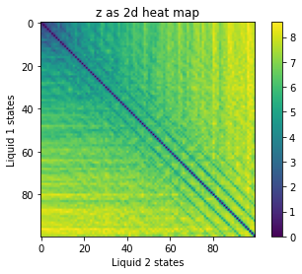
Distance planes
Distance planes
Visualizes the distance between every state of two liquids
Diagonal == distance graph from Maas et al
Cycles can be seen as diagonal lines parallel to the central diagonal

Slide 61
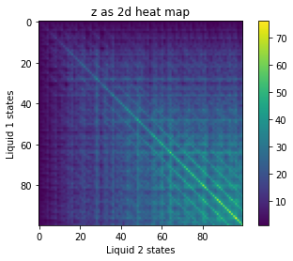
Overlap planes
Distance planes
Visualizes the distance between every state of two liquids
Diagonal == distance graph from Maas et al
Cycles can be seen as diagonal lines parallel to the central diagonal
Overlap planes
Visualizes the number of on cell/neurons that overlap between every state of two liquids
Important in case cycles in distance planes are caused by reduced activity

Slide 62
Simple hybrid system
1D cellular automata running rule 110
Input is the starting state of the cellular automata
Current cellular automata state is used as input to neuron population
Neuron population has lateral connections

Slide 63
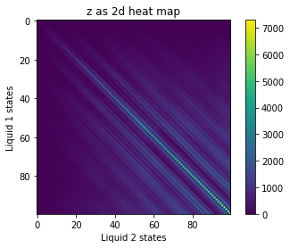
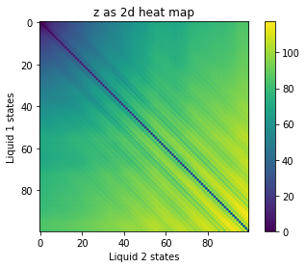
Overlap and separation
Top row :
neural network
Bottom row :
CA
Left column:
Overlap
Right column:
Distance

Slide 64
Overlap and separation
0 distance input
Diagonal line is dark
Indicates that at the same time point the liquids were in identical states

Slide 65
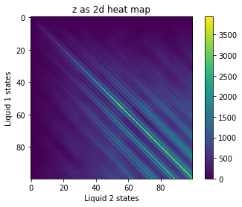
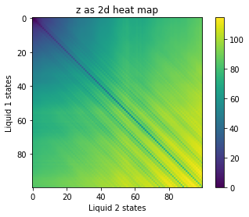
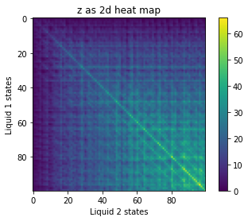
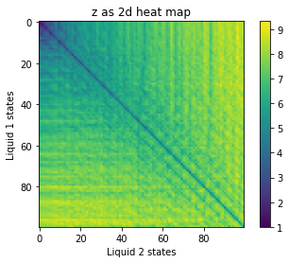
Overlap and separation
small distance input
Diagonal line is lighter
Indicates that the liquids where in similar but not identical states at the same time points

Slide 66
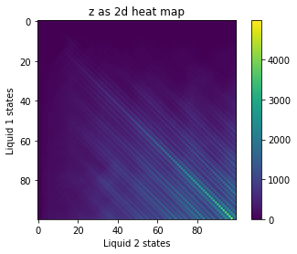
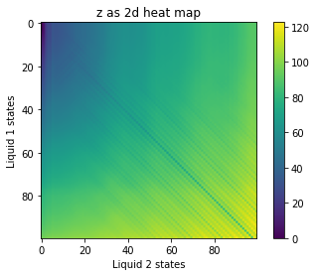
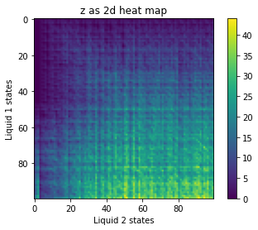
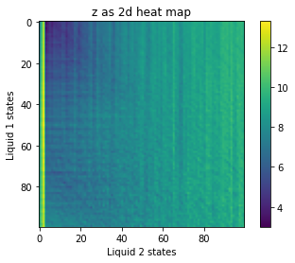
Overlap and separation
Large distance input
No diagonal line in cellular automata
Faint line in neural network

Slide 67
Overlap and separation qualitative analysis
Has the separation property
Distance is > 0
Appears to conserve input distance ratios
Diagonal lines are fainter with larger input distance
Cycles appears longer in neuron population
The distance between diagonal lines parallel to the central is larger
Neurons views the large distance input as more similar than CA does

Slide 68
Memory test
400 x 400 excitatory neurons
Neighbourhood: 7x7
Heteregoneous neuron types
random.rand() used for all parameters
Weight_mean: 0.5, SD: 0.3
(400 x 400)*0.2 inhibitory neurons
Randomly distributed in the 400x400 grid
Neighbourhood: 9x9
Homogenous neuron types
membrane_decay = 0.5, threshold_decay = 0.5, resting distance = 0.5
Weight_mean = 1., SD: 0.3
Connection scheme
Excitatory neuron project to itself and to inhibitory neurons
Inhibitory neurons project to excitatory neurons

Slide 69
Memory test experiment
General description
Neural networks receive an initial stimulation
The same stimulation pattern is then input to the network with increasing time delays from the end of the initial stimulation
Stimulation length = 20
Spike density = 1%
Nr of experiments = 15
Delay increase = 5

Slide 70
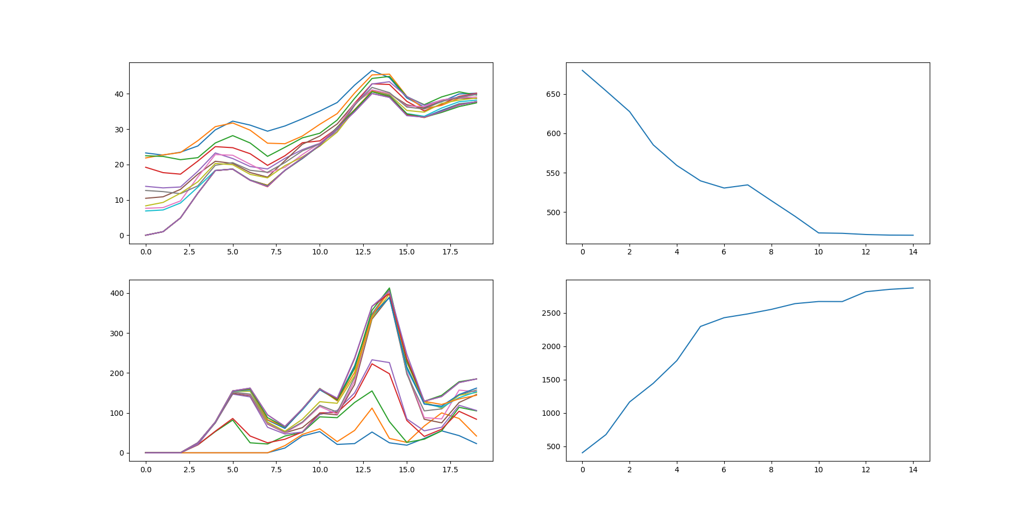
Results
Over delay
(summed over time for each experiment)
Over stimulation time
Distance
Overlap

Slide 71
Interpretation
Memory over experiments
With increasing delay between stimulation the distance between the neuronal response is decreased
The overlap between also increases
These observations suggests that the memory of the previous input pattern decays gradually over time
Memory over stimulation time
Stimulation patterns diverges over time
Overlap appears more unstable, peaking for some trials at maximal distance
??

Slide 72

Future work

Slide 73
Future work - overview
Neuron model improvements
Component based neurons
Morphogenetic engineering of neuron populations
Evolvability
Continuous time implementation
Cellular automata improvements
Heterogenous cellular automata
Evolvability
Construct complete architectures
Columns and deep networks
Simulation of biological neural network + cellular automata interface
Analysis
Separation property
Fading memory tests
Lyapunov exponent
Avalanche distribution

Slide 74
Improving the neuron model
Components based neurons
Pre synaptic terminals (dynamic synapses)
basic form implemented
Post synaptic terminals (weights – learning)
weights: finished
learning: debugging
Dendritic compartment (delay lines – memory)
debugging
Evolvability
Additional features?

Slide 75
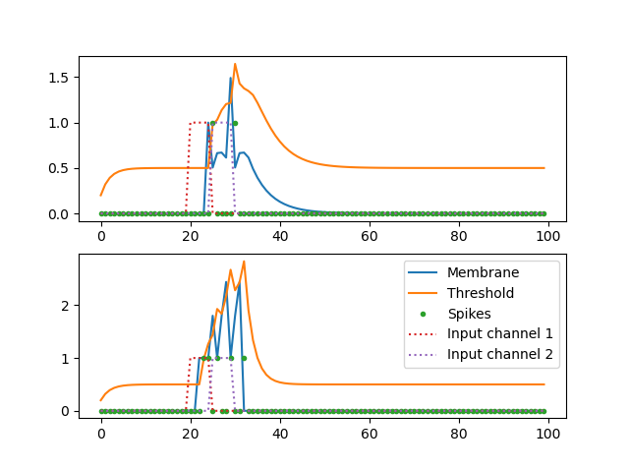
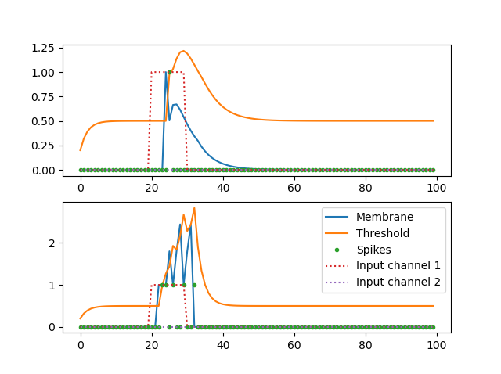
Effect of dynamical synapses
Input separated into two input channels
Input in a single input channels
Dynamic synapse
Static
synapse

Slide 76

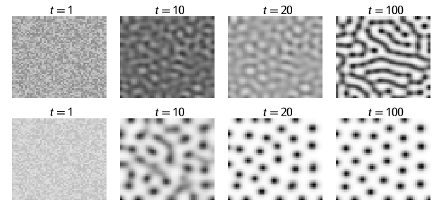
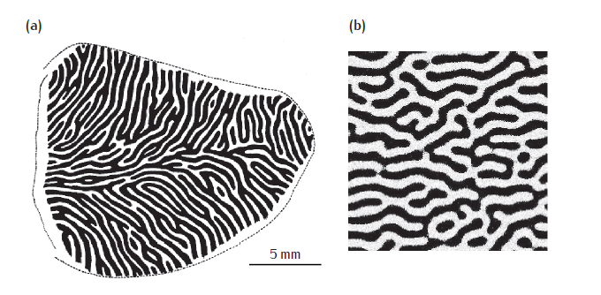
Morphogenetic Engineering
Use a Boolean matrix dependent on activity to create patterns of living/dead cells within a population
Could implement growth rules like a cellular automata
Could implement cell motility within population
Could implement cell differentiation within population
Occular dominace collumns

Slide 77
Cellular automata
Evolvable local rules
Rules are stored locally for each cell, this would allow us to create heterogenous cellular automata
Limited by using a lot of memory for the rules

Slide 78
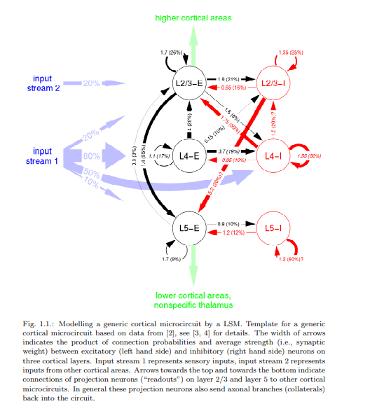
Constructing complete architectures
Implement biologically inspired columns
Implement biologically inspired deep structures
Interface cellular automata

Slide 79
Constructing complete architectures Simulation of biological neural network + cellular automata interface
In vitro biological networks are heterogenous
Create a 2D heterogonous population
Use CA -> Neuron population mapping that simulate MEAs
60 “electrodes”
Measure neuron activity through “MEAs”
Subsample neuron activity

Slide 80
Analysis
Separation property
Use distance planes
What type of distance to use?
Should spike times be smoothed?
What smoothing should be used
Fading memory tests
5 – bit memory test
Can we use distance measures?
Lyapunov exponent
Measure divergence/convergence
Can identify the edge of chaos
Avalanche distribution
Indicative of edge of chaos
Comparison with Lyapunov exponents

Slide 81

Technical implementations:

Slide 82
Implementation: Receptive(projective) field function
Receptive field template (neighbourhood template)
(X * Y) Boolean array
Must be of size (2n+1) * (2n + 1)
The central element corresponds to the output/input neuron
Finds relative position of 1’ to the central element
1 | 1 | 1
1 | 0 | 1
1 | 1 | 1
Notes:
SO on to the implementation. I have here put projective field in brackets. This is because it can be easier to visualize this type of effect from the perspective of the neuron sending out the spikes. In this sense the projective field is the neurons an output neuron is able to send information to.
The key input to the this function is the neighbourhood template. This is a Boolean array which indicates the shape of the projective field in relation to the output neuron. The central element is the position of the output neuron and each element with a 1 is the position of a neuron relative to the output neuron which

Slide 83
Implementation: Receptive(projective) field function
Receptive field template (neighbourhood template)
Finds the relative position of every cell containing a 1
[(-1,-1), (-1,0), (-1,1), (0,-1), (0,1), (1,1), (1,0), (1,-1)]
1 | 1 | 1
1 | 0 | 1
1 | 1 | 1
Notes:
In the implementation I have created

Slide 84
Implementation: Receptive(projective) field function
Receptive field template (neighbourhood template)
Transparent grids represent the projected activity of the neuron array (solid grid)
[(-1,-1), (-1,0), (-1,1), (0,-1), (0,1), (1,1), (1,0), (1,-1)]
Current shift has moved the array 1 down and 1 left of the original position
1 | 1 | 1
1 | 0 | 1
1 | 1 | 1
Notes:
In the implementation I have created

Slide 85
Implementation: Receptive(projective) field function
Receptive field template (neighbourhood template)
[(-1,-1), (-1,0), (-1,1), (0,-1), (0,1), (1,1), (1,0), (1,-1)]
1 | 1 | 1
1 | 0 | 1
1 | 1 | 1
Notes:
In the implementation I have created

Slide 86
Implementation: Receptive(projective) field function
Receptive field template (neighbourhood template)
[(-1,-1), (-1,0), (-1,1), (0,1), (0,1), (1,1), (1,0), (1,-1)]
1 | 1 | 1
1 | 0 | 1
1 | 1 | 1
Notes:
In the implementation I have created

Slide 87
Implementation: Receptive(projective) field function
Receptive field template (neighbourhood template)
[(-1,-1), (-1,0), (-1,1), (0,1), (0,1), (1,1), (1,0), (1,-1)]
1 | 1 | 1
1 | 0 | 1
1 | 1 | 1
Notes:
In the implementation I have created

Slide 88
Implementation: Receptive(projective) field function
Receptive field template (neighbourhood template)
[(-1,-1), (-1,0), (-1,1), (0,1), (-1,1), (1,1), (1,0), (1,-1)]
1 | 1 | 1
1 | 0 | 1
1 | 1 | 1
Notes:
In the implementation I have created

Slide 89
Implementation: Receptive(projective) field function
Receptive field template (neighbourhood template)
[(-1,-1), (-1,0), (-1,1), (0,1), (0,1), (1,0), (1,0), (1,-1)]
1 | 1 | 1
1 | 0 | 1
1 | 1 | 1
Notes:
In the implementation I have created

Slide 90
Implementation: Receptive(projective) field function
Receptive field template (neighbourhood template)
[(-1,-1), (-1,0), (-1,1), (0,1), (0,1), (1,1), (1,1), (1,-1)]
1 | 1 | 1
1 | 0 | 1
1 | 1 | 1
Notes:
In the implementation I have created

Slide 91
Implementation: Receptive(projective) field function
Receptive field template (neighbourhood template)
[(-1,-1), (-1,0), (-1,1), (0,1), (0,1), (1,1), (1,0), (0,-1)]
1 | 1 | 1
1 | 0 | 1
1 | 1 | 1
Notes:
In the implementation I have created

Slide 92
X
Weights
Notes:
In the implementation I have created

Slide 93
X
Weights
Weights corresponding to a single neuron
Notes:
In the implementation I have created

Slide 94
Implementation: Receptive(projective) field function
Summation across the 3rd dimension
S
U
M
Notes:
In the implementation I have created

Slide 95
Implementation: Receptive(projective) field function
Receptive field template (neighbourhood template)
[(-1,-1), (-1,0), (-1,1), (0,-1), (0,1), (1,1), (1,0), (1,-1)]
1 | 1 | 1
1 | 0 | 1
1 | 1 | 1
Notes:
In the implementation I have created

Slide 96
Implementation: Receptive(projective) field function
Receptive field template (neighbourhood template)
[(-1,-1), (-1,0), (-1,1), (0,-1), (0,1), (1,1), (1,0), (1,-1)]
1 | 1 | 1
1 | 0 | 1
1 | 1 | 1
input
Notes:
In the implementation I have created

Slide 97
Implementation: Receptive(projective) field function
Receptive field template (neighbourhood template)
[(-1,-1), (-1,0), (-1,1), (0,-1), (0,1), (1,1), (1,0), (1,-1)]
1 | 1 | 1
1 | 0 | 1
1 | 1 | 1
Notes:
In the implementation I have created

Slide 98
Implementation: Receptive(projective) field function
Receptive field template (neighbourhood template)
The 1’s in the template can be organized in any way, for example projecting downwards
0 | 0 | 0
0 | 0 | 0
1 | 1 | 1
Notes:
In the implementation I have created

Slide 99
Implementation: Receptive(projective) field function
Receptive field template (neighbourhood template)
[(-1,-1), (-1,0), (-1,-1)]
0 | 0 | 0
0 | 0 | 0
1 | 1 | 1
Notes:
In the implementation I have created

Slide 100
Implementation: Receptive(projective) field function
Receptive field template (neighbourhood template)
[(-1,-1), (-1,0), (-1,-1)]
0 | 0 | 0
0 | 0 | 0
1 | 1 | 1
Notes:
In the implementation I have created

Slide 101
Implementation: Receptive(projective) field function
Receptive field template (neighbourhood template)
[(-1,-1), (-1,0), (-1,-1)]
0 | 0 | 0
0 | 0 | 0
1 | 1 | 1
Notes:
In the implementation I have created

Slide 102
Implementation: Receptive(projective) field function
Receptive field template (neighbourhood template)
[(-1,-1), (-1,0), (-1,-1)]
0 | 0 | 0
0 | 0 | 0
1 | 1 | 1
S
U
M
Notes:
In the implementation I have created

Slide 103
Implementation: Receptive(projective) field function
Receptive field template (neighbourhood template)
[(-1,-1), (-1,0), (-1,-1)]
0 | 0 | 0
0 | 0 | 0
1 | 1 | 1
Notes:
In the implementation I have created

Slide 104
Implementation: Receptive(projective) field function
Receptive field template (neighbourhood template)
[(-1,-1), (-1,0), (-1,-1)]
0 | 0 | 0
0 | 0 | 0
1 | 1 | 1
input
Notes:
In the implementation I have created

Slide 105
Implementation: Receptive(projective) field function
Receptive field template (neighbourhood template)
[(-1,-1), (-1,0), (-1,-1)]
0 | 0 | 0
0 | 0 | 0
1 | 1 | 1
Notes:
In the implementation I have created

Slide 106
1D Cellular automata

Slide 107
Implementation: 1D -> 2D projection
Current state is stored at index [0,:] of a 2D array
Automata state at time t is stored in column at index t
Time
0 | 0 | 0 | 0 | 0
1 | 0 | 0 | 0 | 0
0 | 0 | 0 | 0 | 0
0 | 0 | 0 | 0 | 0

Slide 108
Implementation: 1D -> 2D projection
0
1
0
0
Transition function is applied to the current state
0 | 0 | 0 | 0 | 0
1 | 0 | 0 | 0 | 0
0 | 0 | 0 | 0 | 0
0 | 0 | 0 | 0 | 0

Slide 109
Implementation: 1D -> 2D projection
0
1
0
0
0 | 1 | 0
1 | 0 | 0
0 | 0 | 1
0 | 0 | 0
0 | 0 | 0 | 0 | 0
1 | 0 | 0 | 0 | 0
0 | 0 | 0 | 0 | 0
0 | 0 | 0 | 0 | 0
Neighbourhood is projected into a 2D array using the same receptive field function as the neuron model

Slide 110
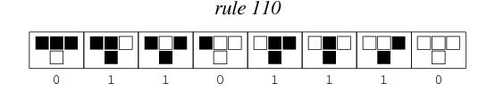
Implementation: 1D -> 2D projection
Neighbourhood size
0
1
0
0
0 | 1 | 0
1 | 0 | 0
0 | 0 | 1
0 | 0 | 0
Automata size
Nr of transitions to 1
0
1
0
0
1
0
0
1
0
0
1
0
0 | 0 | 0 | 0 | 0
1 | 0 | 0 | 0 | 0
0 | 0 | 0 | 0 | 0
0 | 0 | 0 | 0 | 0
Rules are stored in a 3D array
Only rules that transition to 1 is stored in the rule matrix
1st dimension equals the position of cells in the 1D automata
2nd dimension stores a rule
3rd dimension indexes different rules

Slide 111
Implementation: 1D -> 2D projection
Neighbourhood size
0
1
0
0
0 | 1 | 0
1 | 0 | 0
0 | 0 | 1
0 | 0 | 0
Automata size
==
Nr of transitions to 1
0
1
0
0
1
0
0
1
0
0
1
0
0 | 0 | 0 | 0 | 0
1 | 0 | 0 | 0 | 0
0 | 0 | 0 | 0 | 0
0 | 0 | 0 | 0 | 0
The 2D neighbourhood array is checked for equality against each slice of the 3D rule array

Slide 112
Implementation: 1D -> 2D projection
Neighbourhood size
0
1
0
0
0 | 1 | 0
1 | 0 | 0
0 | 0 | 1
0 | 0 | 0
Automata size
==
Nr of transitions to 1
1
1
1
0
0
1
1
0
0
1
0
1
0 | 0 | 0 | 0 | 0
1 | 0 | 0 | 0 | 0
0 | 0 | 0 | 0 | 0
0 | 0 | 0 | 0 | 0
If a rule is fulfilled for a an element every index in the 2nd dimension will be 1’s

Slide 113
Implementation: 1D -> 2D projection
Neighbourhood size
Automata size
Nr of transitions to 1
1
1
1
0
0
1
1
0
0
1
0
1
0 | 0 | 0 | 0 | 0
1 | 0 | 0 | 0 | 0
0 | 0 | 0 | 0 | 0
0 | 0 | 0 | 0 | 0
Taking the product across the 2nd dimension will gives us 1’s only where a rule is fulfilled
Π

Slide 114
Implementation: 1D -> 2D projection
Neighbourhood size
Automata size
Nr of transitions to 1
1
0
0
sum
0
0 | 0 | 0 | 0 | 0
1 | 0 | 0 | 0 | 0
0 | 0 | 0 | 0 | 0
0 | 0 | 0 | 0 | 0
Taking the sum across the new 2nd dimension gives us the new state vector

Slide 115
Implementation: 1D -> 2D projection
1
1
0
0
0 | 0 | 0 | 0 | 0
1 | 0 | 0 | 0 | 0
0 | 0 | 0 | 0 | 0
0 | 0 | 0 | 0 | 0
Taking the sum across the new 2nd dimension gives us the new state vector

Slide 116
Implementation: 1D -> 2D projection
The previous state is moved one step forward
1
1
0
0
0 | 0 | 0 | 0 | 0
1 | 0 | 0 | 0 | 0
0 | 0 | 0 | 0 | 0
0 | 0 | 0 | 0 | 0

Slide 117
Implementation: 1D -> 2D projection
The previous state is moved one step forward
1
1
0
0
0 | 0 | 0 | 0 | 0
0 | 1 | 0 | 0 | 0
0 | 0 | 0 | 0 | 0
0 | 0 | 0 | 0 | 0

Slide 118
Implementation: 1D -> 2D projection
1
1
0
0
0 | 0 | 0 | 0 | 0
0 | 1 | 0 | 0 | 0
0 | 0 | 0 | 0 | 0
0 | 0 | 0 | 0 | 0
The new current state is inserted into the 2D time projection

Slide 119
Implementation: 1D -> 2D projection
1 | 0 | 0 | 0 | 0
1 | 1 | 0 | 0 | 0
0 | 0 | 0 | 0 | 0
0 | 0 | 0 | 0 | 0
The new current state is inserted into the 2D time projection

Slide 120
Implementation: Hybrid model
2D projection of 1D automata
2D spike array
1 | 0 | 0 | 0 | 0
1 | 1 | 0 | 0 | 0
0 | 0 | 0 | 0 | 0
0 | 0 | 0 | 0 | 0
0 | 0 | 0 | 0 | 0
0 | 0 | 0 | 0 | 0
0 | 0 | 0 | 0 | 0
0 | 0 | 0 | 0 | 0
Both state arrays are numpy/cupy arrays
Creating an interface is simply done by projecting parts of one array into the other

Slide 121
Implementation: Hybrid model
2D projection of 1D automata
2D spike array
1 | 0 | 0 | 0 | 0
1 | 1 | 0 | 0 | 0
0 | 0 | 0 | 0 | 0
0 | 0 | 0 | 0 | 0
0 | 0 | 0 | 0 | 0
0 | 0 | 0 | 0 | 0
0 | 0 | 0 | 0 | 0
0 | 0 | 0 | 0 | 0
Current implementation takes the last element of the 2D projection of cellular automata state and inputs it to the first column of the 2D spike array

Slide 122
Implementation: Hybrid model
2D projection of 1D automata
2D spike array
1 | 0 | 0 | 0 | 0
1 | 1 | 0 | 0 | 0
0 | 0 | 0 | 0 | 0
0 | 0 | 0 | 0 | 0
0 | 0 | 0 | 0 | 0
0 | 0 | 0 | 0 | 0
0 | 0 | 0 | 0 | 0
0 | 0 | 0 | 0 | 0
Inputs can be extracted in any regular index format and projected into any regular index format

Slide 123
2D Cellular automata

Slide 125
Unfinished and leftover frames

Slide 126
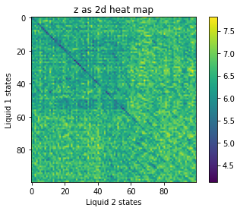
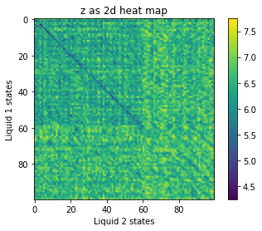
Fading memory – similarity
Starting state is random
Time series inputed from timestep 0 to 60
How long does the diagonal line stay dark after the input stops?

Slide 127
Future work – hierarchical genome
The hierarchical organization of the network makes a hierarchical genome possible
Evolving new populations or entire functional area in one mutation will allow for growth of a larger brain
Implementation:
Low level genes encode basic features
Membrane decay
Threshold decay
Neighbourhood template
Higher level genes points to sets of low level genes and connects populations
Encode populations of neurons
Encode connections between populations

Slide 128
Future work – hierarchical genome Low level genes
Stored in dictionaries
Membrane_decay = {ADTT:0.5, AAGT:0.3, ADAT:01, ADAA:0.8}
Mutation types:
Point mutation
Changes value of variable in gene
Copy mutation
Copies value in dict element
Changes key
Membrane decay genome
Threshold decay genome
Projection template template genome
GGGTA: [1,0,1,1,0]
[1,1,1,0,0]
[1,0,0,1,1]
[1,1,1,1,1]
[1,1,1,1,1]
AGGT: [1,0,1]
[1,1,1]
[1,0,0]
AAAGT: [1,1,1]
[1,0,1]
[1,1,1]
ATTGT: [1,1,1]
[1,1,1]
[1,1,1]
ADTT: 0.5
AAGT: 0.3
ADAT: 0.1
ADAA: 0.8
AAAT: 0.5
GGGT: 0.3
TTTT: 0.1
GAAA: 0.8

Slide 129
Future work – hierarchical genome population genes
Population genes contain dicts with values corresponding to genes in low level dicts
They are themselves entries in a population genome dict
{ AAGGTA:{
{Membrane_decay:ADDT},
{Threshold_decay:AAAT},
{Projection_template: GGGTA}
},
AAAATG: {
{Membrane_decay:AGGT},
Threshold_decay:AAAT},
Projection_template: AAGTA},
}
}
Mutations:
Point mutations changes genes in feature dicts
Can only change to existing genes in the feature dicts
Copy mutations copies the population gene and changes one of the values in the Gene
Population genome
AAGGTA
AAAATG
Membrane decay:
ADTT
Threshold decay:
GGGT
Projection template:
AAAGT
Membrane decay:
ADTT
Threshold decay:
GGGT
Projection template:
AAAGT

Slide 130
Future work – hierarchical genome
Weight parameters
genome
GGTA
GGTA
GGTA
GGTA
GGTA
Type: normal
Mea: ADTT
SD:
ADAT
Type: normal
Mea: ADTT
SD:
ADAT
Type: normal
Mea: ADTT
SD:
ADAT
Type: uniform
Upper bound:
ADTT
Lower bound: ADTT
Type: uniform
Upper bound:
ADTT
Lower bound: ADTT
Key in weight parameters genome
The element is a dict containing key:element assosiations for type and gene codes
Mean genome
SD genome
Upper bound genome
Lower bound genome
ADTT: 0.5
AAGT: 0.3
ATAT: 0.1
ADAT: 0.1
ADTT: 0.5
AAGT: 0.3
ATAT: 0.1
ADTT: 0.5
AAGT: 0.3
ATAT: 0.1

Slide 131
Future work – hierarchical genome
Functional area gene
Population gene
Population gene
Population gene
Population gene
Population gene
Membrane decay
Threshold decay
Resting difference
Connection gene
Membrane decay
Threshold decay
Resting difference
Connection gene
Membrane decay
Threshold decay
Resting difference
Connection gene
Connection gene
Resting difference

Slide 132
ADTT: 0.5
AAGT: 0.3
ATAT: 0.1
ADAT: 0.1
ADTT: 0.5
AAGT: 0.3
ATAT: 0.1
ADTT: 0.5
AAGT: 0.3
ATAT: 0.1
AAGT: 0.3
ATAT: 0.1
ADAT: 0.1
ADTT: 0.5
AAGT: 0.3

Slide 133
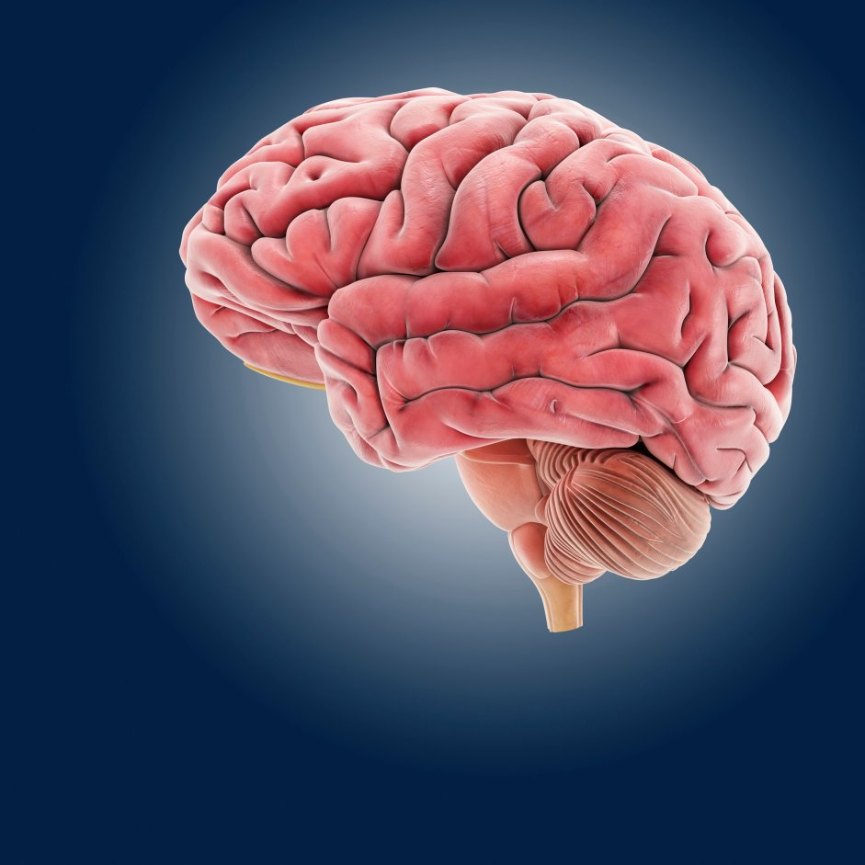
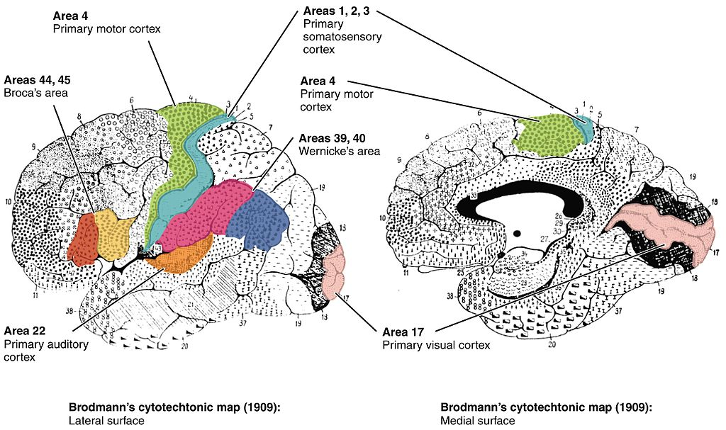
Macroscale organization
The brain is divided into different functional areas
Notes:
The large scale organization of the brain divides different parts of the brain into functional areas responsible for performing specific tasks.
This functional separation is the reason why someone who experiences a stroke, or suffers a lesion in the brain might loose strangely specific capabilities.
The classical example is the loss of the ability to distiniguish facial identity. One can still recognize that one is looking at a face, but the identity eludes you.
Stranger example exists though, like loosing the ability to see motion or color

Slide 134
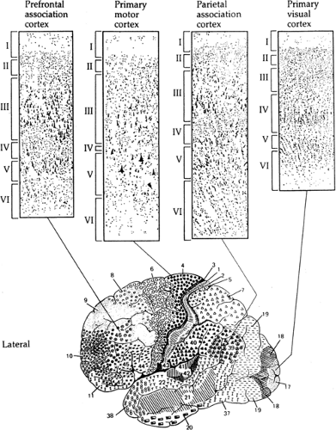
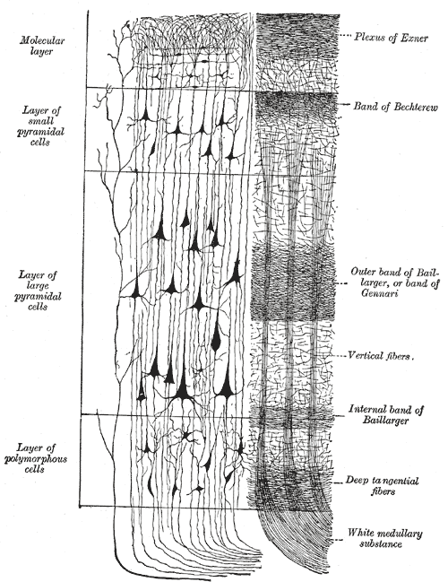
Cytoarchitecture
Different functional areas contain different types of neurons
The cortex has a variable but stereotypical columnar organization within cortical areas
Notes:
The different functional areas of the brain are also structurally distinct. We can see this in the drawing on the left which shows a brain atlas of the Brodman areas deliniated by their difference in architecture and the neuron types found in each area.
The neocortex can be further divided into layered cortical columns. If we think of each brain area as 3D sheet, and if we slice one of these sheets perpendicularly to its surface we will see a repeating organization of layers of neurons or neurons processes.
These layers also contain different neuron types. In the middle figure you can see how small pyramidal neuron are contained in the second topmost layer while larger pyramidal cells are found in the layer bellow these.
Cortical columns are connected in a varying but stereotypical fashion of which you can see a diagram in the leftmost image.

